Slide 1


INTRODUCTION TO WEB DEVELOPMENT
A webinar by
Inception Wave Student Chapter SRM

Slide 2
Web Development
An Introduction

Slide 3





What are we going to discuss in this webinar?
JS

Slide 4
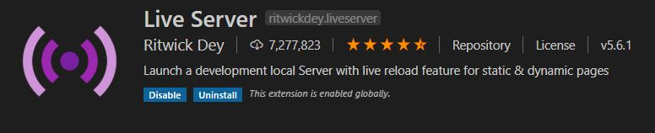
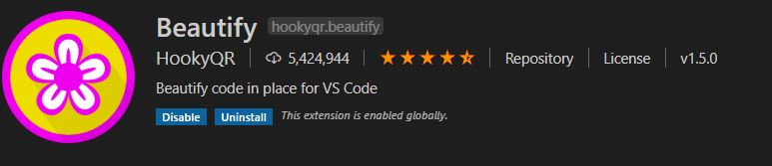
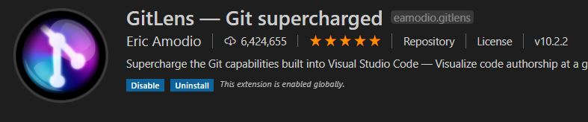
Let’s talk about IDE’s and extensions

Slide 5
What is HTML?

Slide 6
HTML Tags[<>….</>]
Header tags[<h1>….<h6>]
Paragraph tags[<p>]
Hyperlink tag[<a>]
Form[<form>] and it’s tags <label> and <input>
There are more tags such as : <ol> for Ordered List, <ul> for Unordered List,Table tag[<table>],etc.
Self closing tags[<br />,<hr />,<img />,<link />]

Slide 7
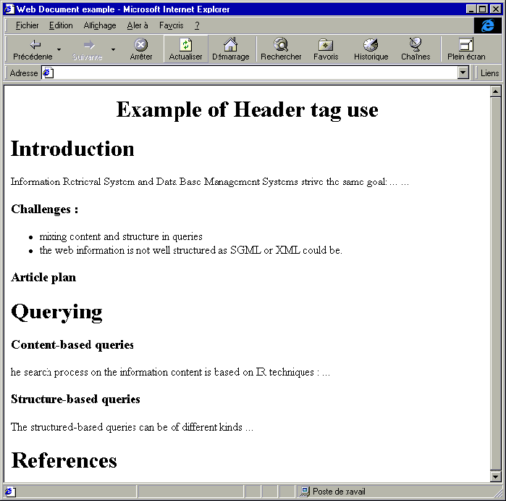
Some demo using only HTML:

Slide 8
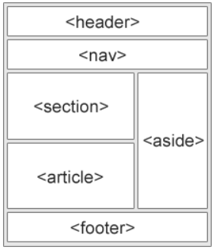
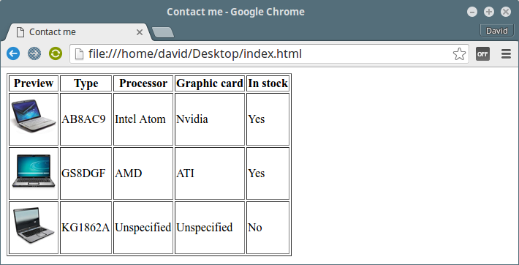
HTML LAYOUT

Slide 9
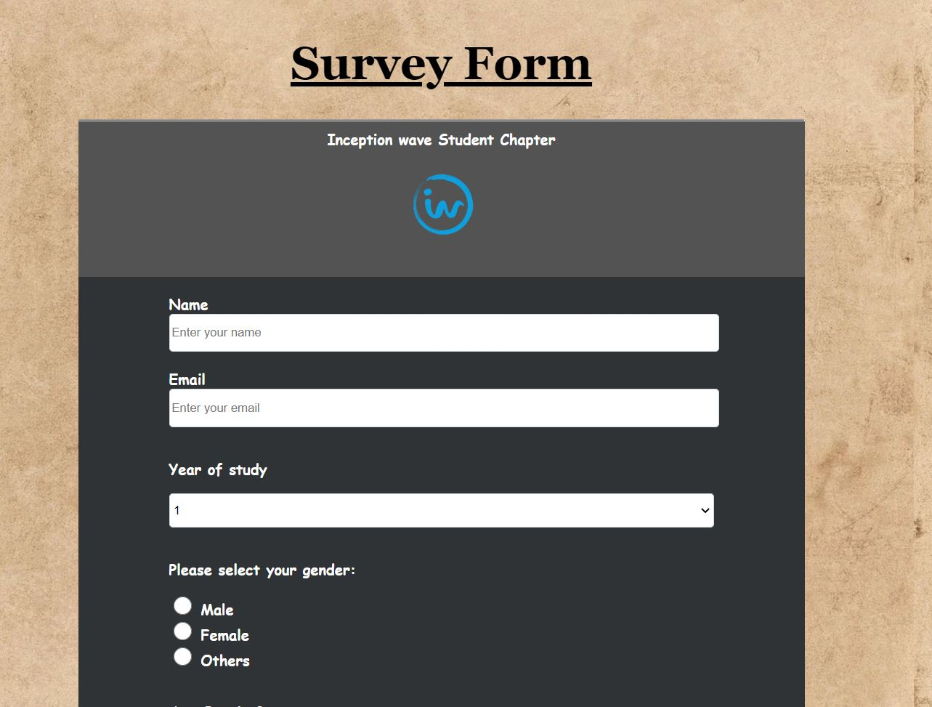
What have we built today?

Slide 10
What is CSS?

Slide 11



CSS Rules
p { color: red; }
.class-name { font-size: 20px; }
#demo { font-style: italic; }

Slide 12
CSS Specificity
#id > .class > tag
Example -
#introduction{ color: red;}
.message{ color: green;}
p{ color: blue;}
What are inline styles?

Slide 13
CSS – Font Sizing
px: pixels;
vw/vh: viewport width/viewport height;
em: references nearest defined parent element;
rem: relational to font-size of html tag;

Slide 14
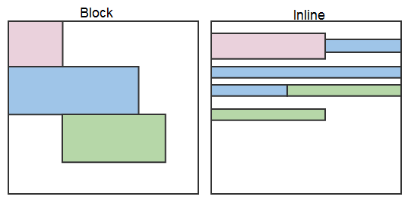
CSS Properties : Display
block;
inline;
none;

Slide 15
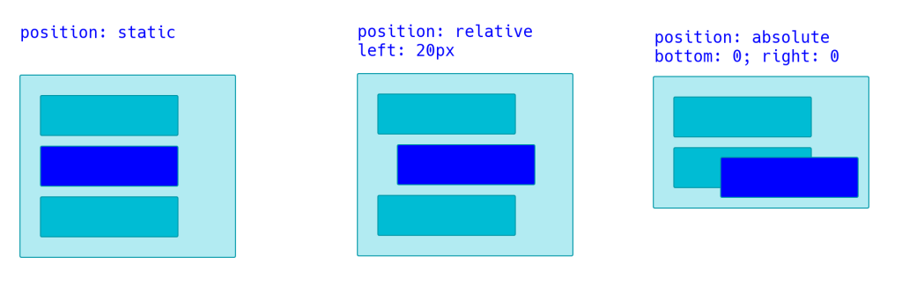
CSS Properties : Position
static;
relative;
fixed;
absolute;

Slide 16
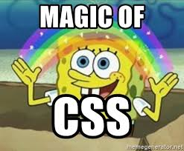
Wonders of CSS
CSS Grid
CSS Frameworks
Reference : https://developers.google.com/web/updates/2012/06/The-amazing-powers-of-CSS

Slide 17

CSS Properties : Media Queries
@media only screen and (max-width : __px){
body{background-color:red;}
}
@media only screen and (min-width : __px){
body{background-color:yellow;}
}

Slide 18

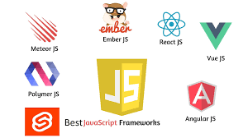
What is Javascript?
Notes:
Ask some questions rhetorically between Java and Javascript Adds functionality to a page, actions like toggling, adds interactivity to a webpage. JavaScript is a scripting language that enables you to create dynamically updating content, control multimedia, animate images

Slide 19
Basics of Javascript
Variables
Keywords[new,break,var,for,if,while,this,void…]
Reserved keywords[import,Boolean,int,class..]
Functions

Slide 20

DOM Manipulation

Slide 21
Event Listeners in Javascript
Syntax : element.addEventListener(“click”,myFunction);
click;
mouseover;
mouseout;
resize;

Slide 22
Let’s explore Chrome Dev Tools!!

Slide 23
Let’s play with Javascript!!

Slide 24
console.log(‘We did it’)

Slide 25
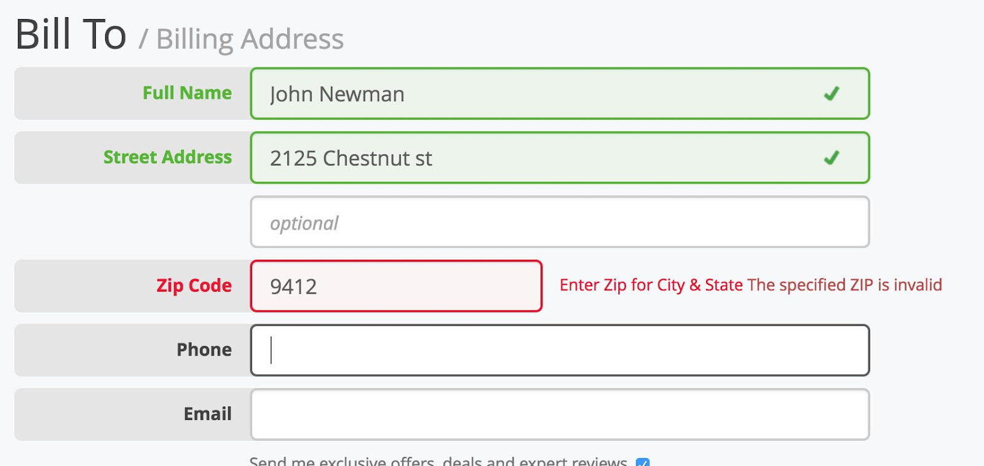
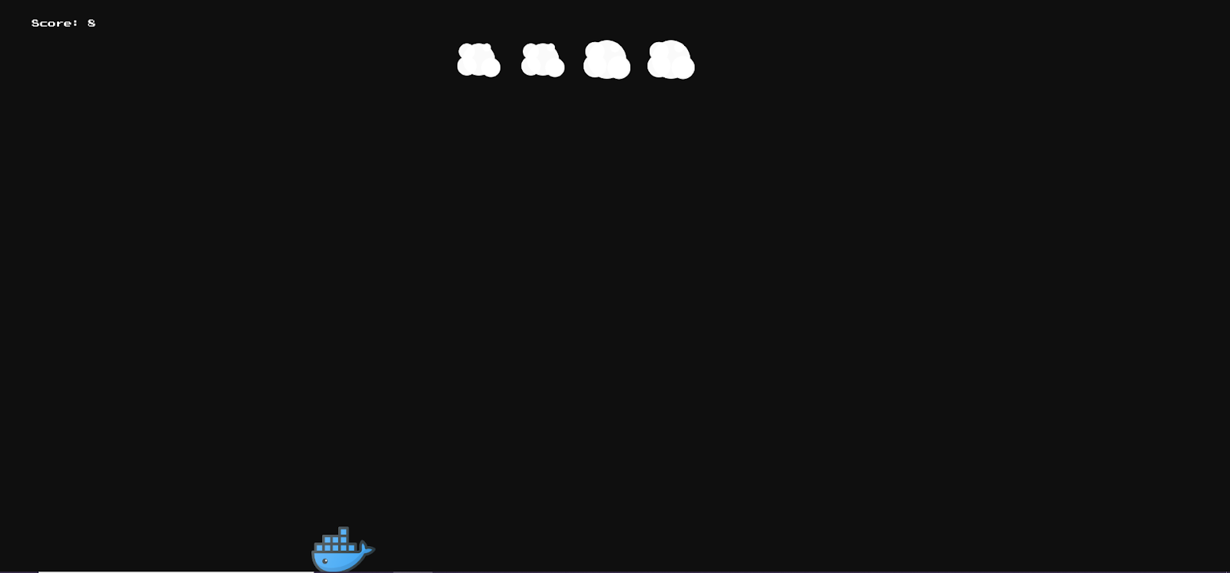
What more can we do with Javascript?

Slide 26
Recap of what we have done upto now?
Editor -> VS Code and Extensions
HTML -> Basic Tags and Structure
CSS -> Styling and Responsive
Javascript -> DOM Manipulation
Google Chrome DevTools and its uses

Slide 27
Resources for Web Development:
https://roadmap.sh
https://devdocs.io
https://docs.google.com/document/d/1Uy7zybjFecFWmW2xTbYKN8t-JhG0_hlJzW6xJjkUA-I/edit

Slide 28
HTML resources -
http://overapi.com/html
https://www.w3schools.com/html/
Javascript resources -
https://eloquentjavascript.net/
https://github.com/getify/You-Dont-Know-JS
CSS Resources -
https://css-tricks.com/snippets/css/a-guide-to-flexbox/
https://css-tricks.com/snippets/css/complete-guide-grid/
https://css-tricks.com/centering-css-complete-guide/
https://www.w3schools.com/css/
http://overapi.com/css
http://learnlayout.com/
https://adamschwartz.co/magic-of-css/

Slide 29

console.log(‘Thank you 😃’)
@iwscsrm

